Slide 1

National Program LecturaCentral - strengthening efforts to promote reading
June 6th, 2026
VII OdesaBiblioSummit
Prezentation by:
Mariana Kiriakov, chief specialist
Managerial Support and International Relations section
Vera Osoianu, Deputy Director of Research and Development in Library and Information Science

Slide 2
PROGRAM OVERVIEW
• 8 editions (years) of the National Reading Program LecturaCentral / Programul Național LecturaCentral / PLNC
• One of the key national initiatives for reading promotion
• Coordinated by the National Library of the Republic of Moldova
• Focus: reading, libraries, community engagement

Slide 3

KEY RESULTS (2025)
• Public lectures & conferences
• Book promotion initiatives
• National reading competitions
• Regional library conferences
• Methodological support and training programs

Slide 4

INTERNATIONAL CONTEXT
• Reading Agency (UK)
• ProLectura Foundation (Germany)
• Institutions in Poland, France, USA, Romania
• Adapted to Moldovan cultural context

Slide 5
PROGRAM DEVELOPMENT
• From quotation-based promotion → to active community engagement
• From general reading advocacy → to targeted cultural programs
• Increasing involvement of contemporary cultural personalities
• Development of an original national model

Slide 6

“THE WRITER AT HOME” CAMPAIGN
(2025)
• 55 writers involved
• 156 events
• 89 localities
• ~15,000 participants
• Direct dialogue between writers and communities

Slide 7

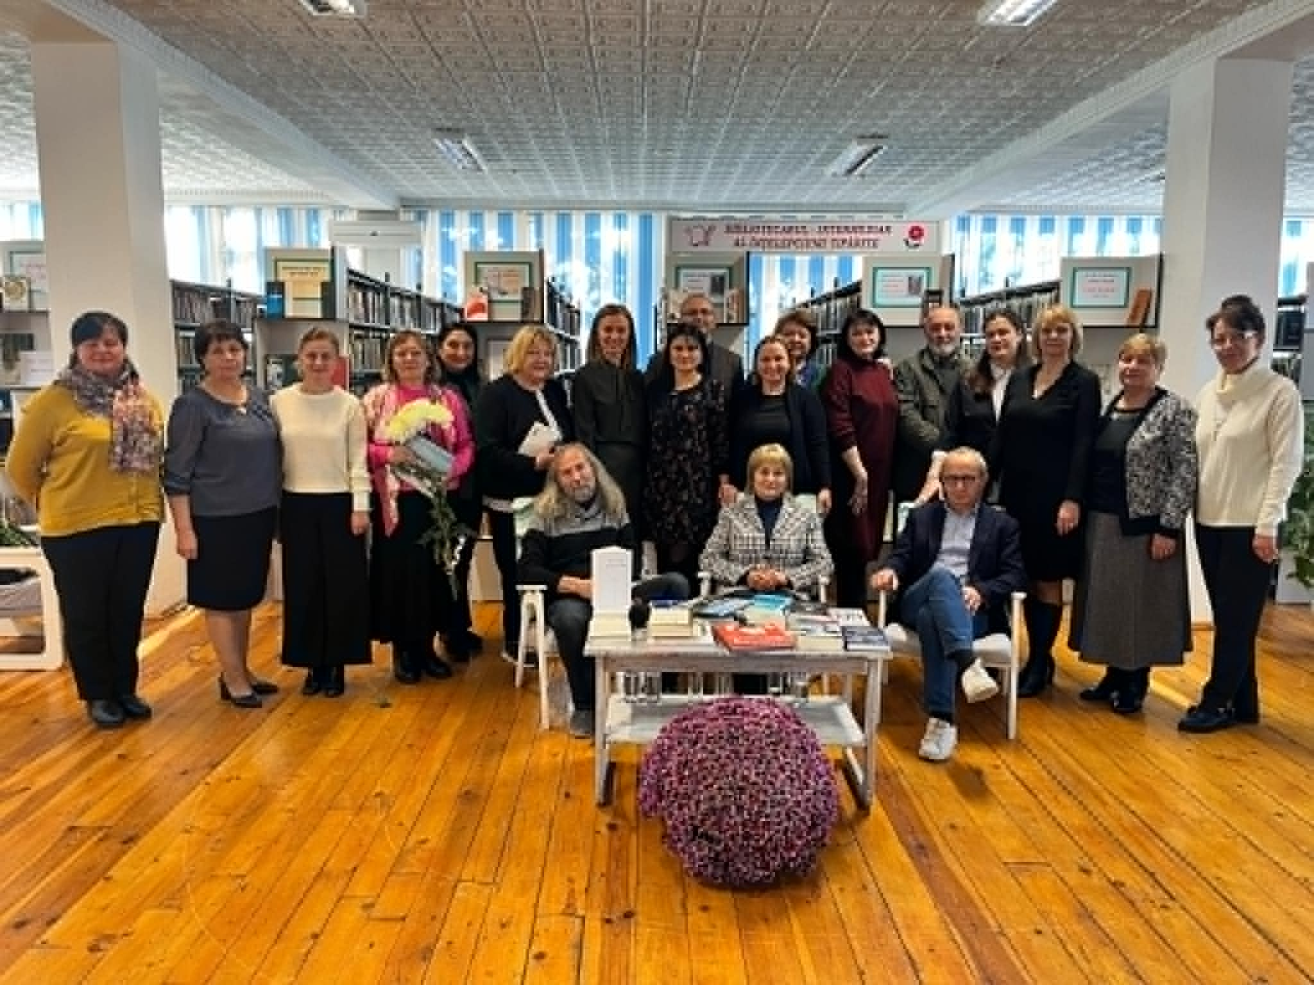
Meeting with Emilian Galaicu Păun, Claudia Partole, Gheorghe Erizanu (Ungheni)

Slide 8
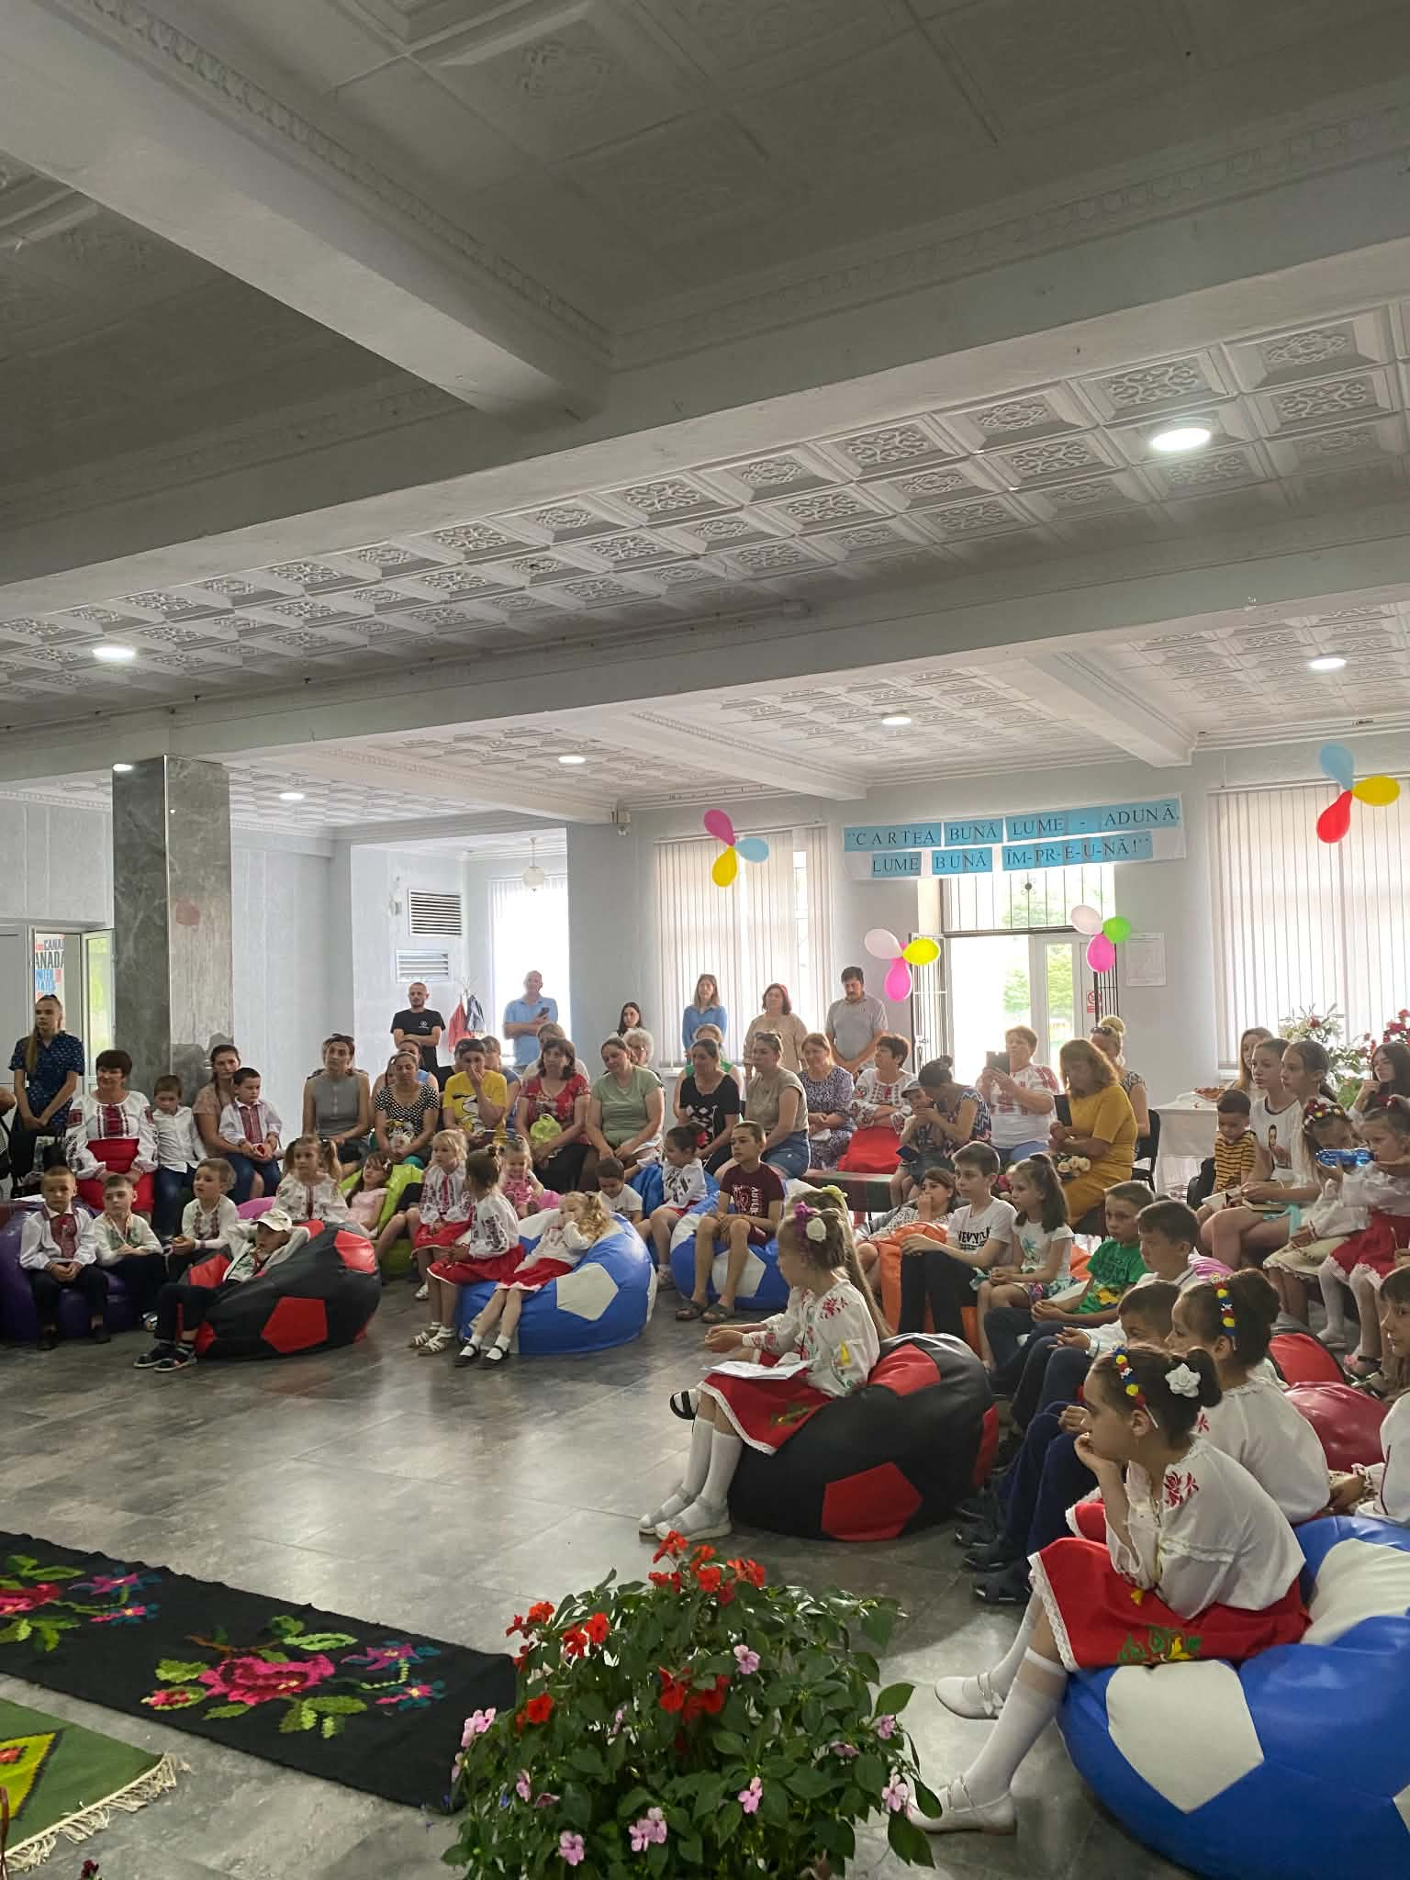
Meeting with writers (Strășeni)

Slide 9
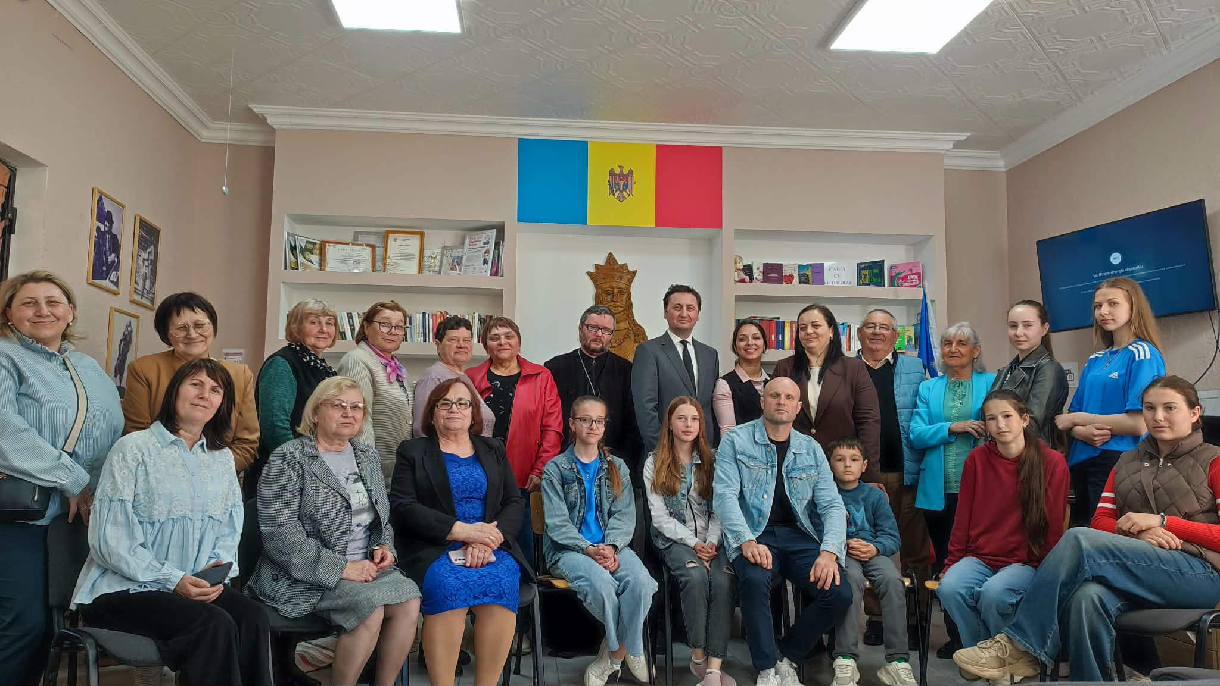
Meeting with writers

Slide 10
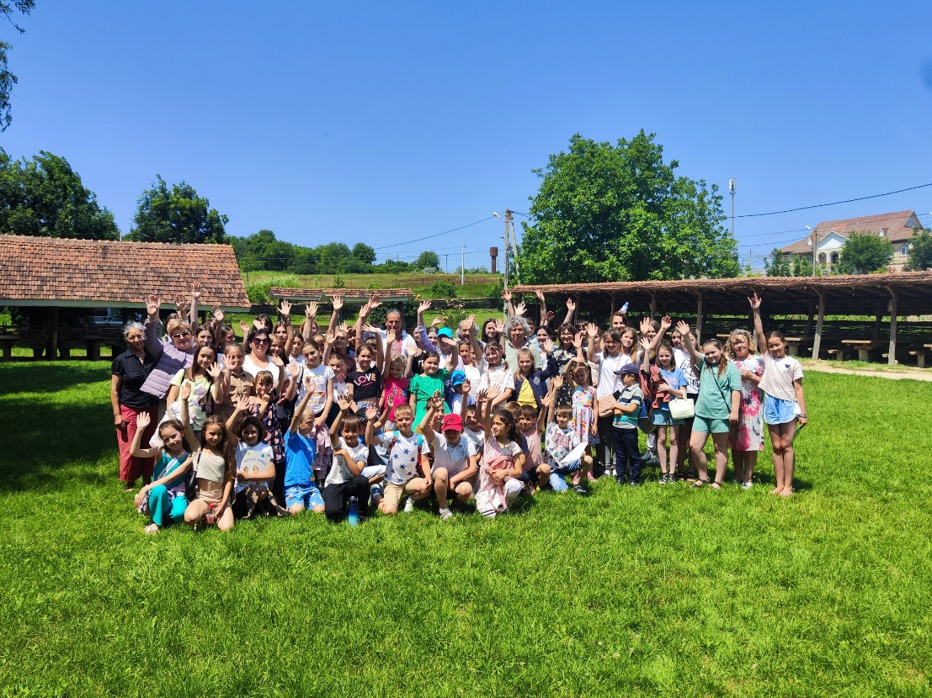
Meeting with writers

Slide 11
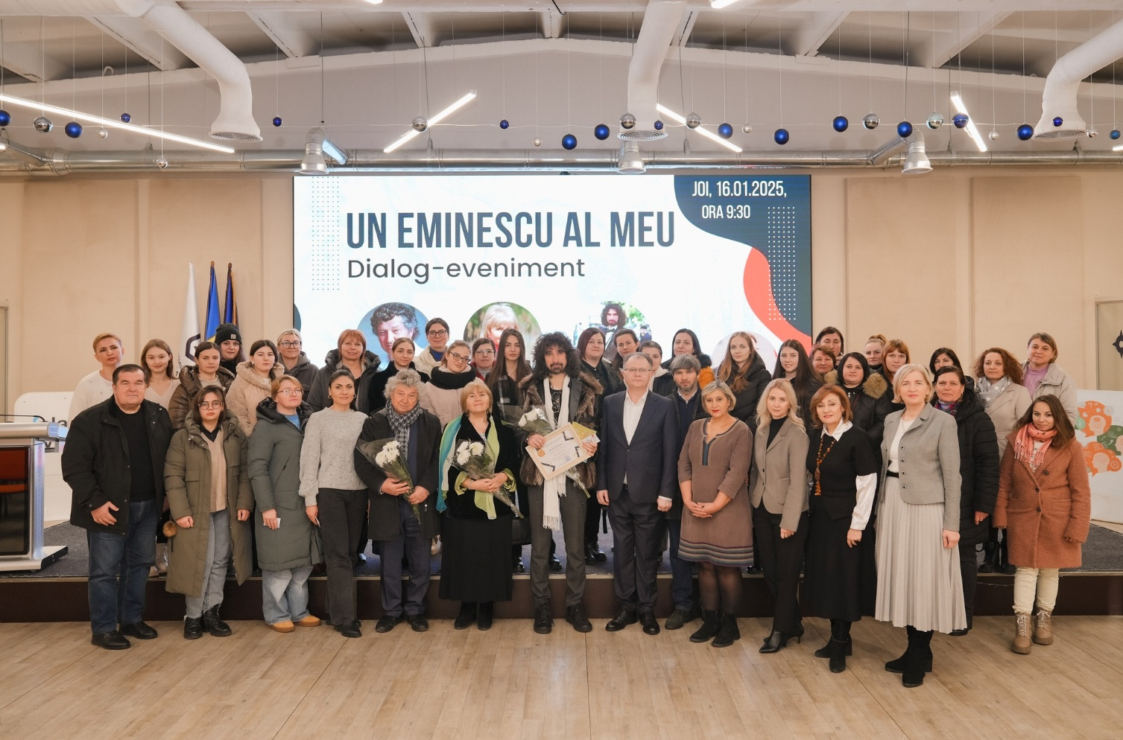
Meeting with writers

Slide 12
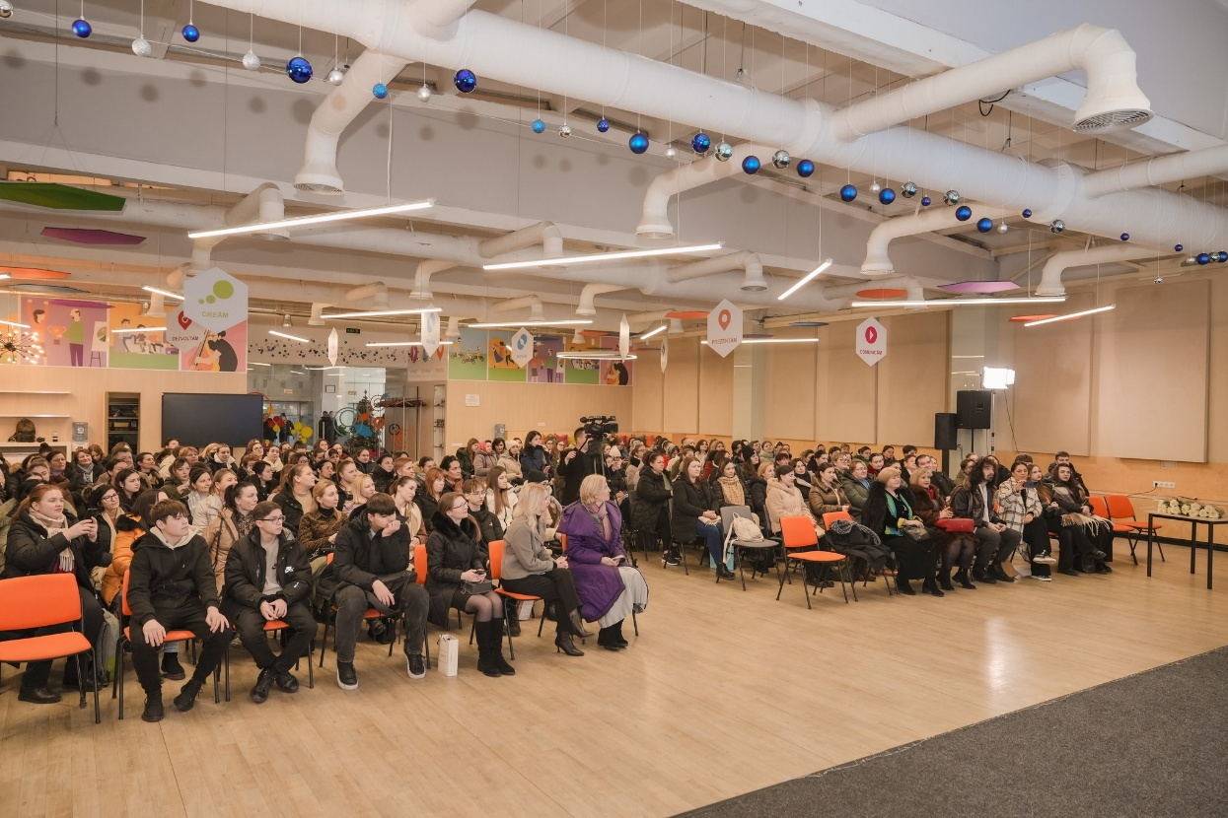
Meeting with writers

Slide 13

CULTURUL MEMORY DIMENSION
• 1946–1947 famine commemoration
• Stalinist deportations
• Public discussions & commemorative events
• Meetings with writers and historians
• Libraries as memory spaces

Slide 14

EUROPEAN VALUES through Reading
• Reading as a tool for civic education
• Promotion of democratic and European values
• Support for cultural identity and dialogue
• Link with European integration process

Slide 15
INTERNATIONAL CONFERENCE
“Reading as a Basis for Culture, Knowledge and Development”
• 7 editions (2019–2025)
• 6,000+ participants
• 150 speakers / 15 countries
• Topics: literacy, AI, digital reading

Slide 16
LIBRARIES and NETWORKS
•Cascading model of implementation:
National Library → regional centers → local libraries
•Strengthening rural library networks
•Increasing community participation
•Improving visibility of libraries

Slide 17
DIGITAL PLATFORM
LecturaCentral Online Platform
• 5,532 members
• 326,000+ views
• 13,000+ posts
• Professional collaboration space
• Digital skills development for librarians

Slide 18
NP LecturaCentral 2026
Planned:
•70 activities
• Campaign “September – no day without reading”,
• 2 social initiatives;
• 5 activities for community members in physical and social difficulty;
• 4 national competitions to promote books and reading

Slide 19
NP LecturaCentral 2026
• Expected participants of NPLC events in 2026- around 30,000
• Donation of 70 sets (698 volumes) of books for libraries, homes / nursing homes for the elderly, the libraries of 2 prisons as part of social initiatives to support people with physical and social disabilities
• Writers, historians, experts, etc. involved – 35

Slide 20
International Conference 2026
“Reading as a Basis for Culture, Knowledge, and Development”
23 September 2026
Chisinau, NL Moldova
online/ offline
Invited: NL Lithuania, NL Latvia, NL Bulgaria, NL Poland, NL Romania (CENL grant)

Slide 21

International Conference 2026
• The role of reading in personal and social development
• Reading and lifelong learning
• National reading strategies and policies
• Reading and artificial intelligence
• Reading as a tool to overcome inequalities
• Reading as a tool for social and cultural inclusions

Slide 22
CONCLUSIONS
• Reading = cultural + social + educational tool
• Libraries = community development centers
• PNLC = scalable national model
• Strong impact on culture and professional development

Slide 23
Final Message
“Libraries remain essential spaces for culture, dialogue, education, and social cohesion”.

Slide 24

Thank You for your attention!

